Slide 1
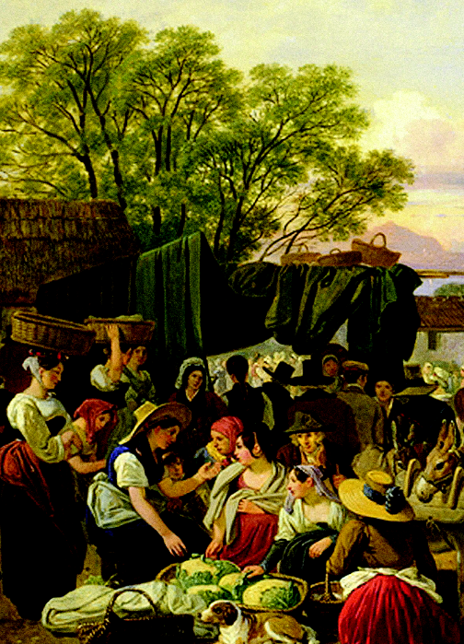

N. Gregory Mankiw
Brief Principles of
Macroeconomics
Sixth Edition
5
Notes:
It would be helpful to have your students bring their calculators to class for this chapter so they can practice calculating real and nominal GDP and so forth.
This is the first purely macro chapter in the textbook. It covers the definition of GDP, the spending components of GDP, real vs. nominal GDP, the GDP deflator, and why GDP is a useful but not perfect measure of a nation’s well-being.

Slide 2
In this chapter, look for the answers to these questions:
What is Gross Domestic Product (GDP)?
How is GDP related to a nation’s total income and spending?
What are the components of GDP?
How is GDP corrected for inflation?
Does GDP measure society’s well-being?

Slide 3
Micro vs. Macro
Microeconomics:
The study of how individual households and firms make decisions, interact with one another in markets.
Macroeconomics:
The study of the economy as a whole.
Notes:
2
This is the first strictly macro chapter of the textbook, so it’s worth spending a moment emphasizing the difference between microeconomics and macroeconomics.
Examples of questions that microeconomics seeks to answer:
How do consumers decide how much of each good to buy?
How do firms decide how much output to produce and what price to charge?
What determines the price and quantity of individual goods and services?
How do taxes on specific goods and services affect the allocation of resources?
Examples of questions that macroeconomics seeks to answer:
How do consumers decide how to divide their income between spending and saving?
What determines the total amount of employment and unemployment?
What determines the overall level of prices and the rate of inflation?
Why does the economy go through cycles, where things are great for a few years (like the late ’90s) and then lousy for a year or two (like 2001–2002)?
When unemployment is high, what can the government do to help?
We begin our study of macroeconomics with income and expenditure….

Slide 4
Income and Expenditure
Gross Domestic Product (GDP) measures
total income of everyone in the economy.
GDP also measures total expenditure on the economy’s output of g&s.
For the economy as a whole,
income equals expenditure
because every dollar a buyer spends
is a dollar of income for the seller.
Notes:
3
Notes:
1. The text in the first bullet point is NOT the formal textbook definition of GDP. The formal definition is given and discussed in detail immediately after the Circular-Flow Diagram.
2. “g&s” = goods and services
A good way to judge how well someone is doing economically is to look at his or her income. We can judge how well a country is doing economically by looking at the total income that everyone in the economy is earning. GDP is our measure of the economy’s total income, often called “national income.”
GDP also measures total expenditure on the goods and services produced in the economy, and the value of the economy’s output (production) of goods and services. Thus, GDP is also referred to as “output.”
The equality of income and expenditure is an accounting identity (not, for example, an equilibrium condition): it must be true that income equals expenditure.

Slide 5
The Circular-Flow Diagram
a simple depiction of the macroeconomy
illustrates GDP as spending, revenue,
factor payments, and income
Preliminaries:
  Factors of production are inputs like labor, land, capital, and natural resources.
  Factor payments are payments to the factors of production (e.g., wages, rent).
Notes:
4
If your students already know the terms “factors of production” and “factor payments,” you may wish to delete the “preliminaries” from this slide.

Slide 6
The Circular-Flow Diagram
Households:
own the factors of production,
sell/rent them to firms for income
buy and consume goods & services
Firms
Households
Firms:
buy/hire factors of production,
use them to produce goods and services
sell goods & services
Notes:
5
This and the following slide build the Circular-Flow Diagram piece by piece.

Slide 7
The Circular-Flow Diagram
Revenue (=GDP)
Spending (=GDP)
Markets for Goods & Services
G & S sold
G & S bought
Firms
Households
Factors of production
Labor, land, capital
Markets for Factors of Production
Wages, rent, profit (=GDP)
Income (=GDP)
Notes:
6
In this diagram, the green arrows represent flows of income/payments. The red arrows represent flows of goods & services (including services of the factors of production in the lower half of the diagram).
To keep the graph simple, we have omitted the government, financial system, and foreign sector, as discussed on the next slide.
Changing the animation on this slide:
If you wish, you can easily change the order in which the markets and arrows appear. From the “Slide Show” drop-down menu, choose “Custom Animation…” Then, a box will appear (maybe along the right-hand-side of your PowerPoint window) that allows you to modify the order in which things appear (as well as other aspects of the animation). For further information, open PowerPoint help and search on “change the sequence of animations.”

Slide 8
What This Diagram Omits
The government
  collects taxes, buys g&s
The financial system
  matches savers’ supply of funds with
  borrowers’ demand for loans
The foreign sector
  trades g&s, financial assets, and currencies with the country’s residents
Notes:
7
In future chapters, we will study the role of each of these in greater detail.
We could draw a more complicated circular flow diagram that includes the government, financial system, and foreign sector. Including them, however, would not change the basic conclusion that GDP simultaneously measures the country’s total income, expenditure, revenue, and factor payments.

Slide 9
Gross Domestic Product (GDP) Is…
…the market value of all final goods & services produced within a country
in a given period of time.
Goods are valued at their market prices, so:
All goods measured in the same units
(e.g., dollars in the U.S.)
Things that don’t have a market value are excluded, e.g., housework you do for yourself.
Notes:
8
This slide and the five that follow focus on the meaning of each part of this critically important definition.
Note that transactions occurring in the so-called “underground economy” are also omitted from the official measure of GDP. In the textbook, near the end of this chapter, an “In the News” box contains an excellent article on the underground economy.

Slide 10
Example
Suppose that there are two countries.
In a country called Microland they produce 100 apples and 2 cars.
In a country called Macroland they produce 2 apples and 100 cars.
Which country is richer/ has higher GDP?
It depends!....on prices = the market value!!!

Slide 11
Example continued
Suppose that an apple costs $1 while a car costs $50,000.
In Microland the GDP would be
$1 x 100 + $50,000 x 2 = $100 + $100,000 = $100,100
In Macroland the GDP would be
$1 x 2 + $50,000 x 100 = $2 + $5,000,000 = $5,000,002

Slide 12
Example continued
Now suppose that an apple costs $1,000, while a car costs $20.
In Microland the GDP would be
$1,000 x 100 + $20 x 2 = $100,000 + $40 = $100,040
In Macroland the GDP would be
$1,000 x 2 + $20 x 100 = $2,000 + $2,000 = $4,000

Slide 13
The Underground Economy

Slide 19
Gross Domestic Product (GDP) Is…
…the market value of all final goods & services produced within a country
in a given period of time.
Final goods: intended for the end user
Intermediate goods: used as components
or ingredients in the production of other goods
GDP only includes final goods—they already embody the value of the intermediate goods
used in their production.
Notes:
18

Slide 20
Example
Consider the Bread production where we produce one loaf of brad that is worth $2.75.

Slide 21
 | Costs |  |  |  | Sale | Value Added
Farmer
$0.80
$0.80
$0.80
Miller
$0.80
$1.00
$1.80
$1.00
Baker
$0.80
$1.00
$0.70
$2.50
$0.70
Retailer
$0.80
$1.00
$0.70
$0.25
$2.75
$0.25
Total
$7.85
$2.75

Slide 22
Gross Domestic Product (GDP) Is…
…the market value of all final goods & services produced within a country
in a given period of time.
GDP includes tangible goods
(like DVDs, mountain bikes, beer)
and intangible services
(dry cleaning, concerts, cell phone service).
Notes:
21

Slide 24
Gross Domestic Product (GDP) Is…
…the market value of all final goods & services produced within a country
in a given period of time.
GDP includes currently produced goods,
not goods produced in the past.
Notes:
23

Slide 25
Gross Domestic Product (GDP) Is…
…the market value of all final goods & services produced within a country
in a given period of time.
GDP measures the value of production that occurs within a country’s borders, whether done by its own citizens or by foreigners located there.
Notes:
24

Slide 26
GDP vs GNP
GNP or Gross National Product is the total income earned by a nation’s permanent residents. It differs from GDP by including income that our citizen earn abroad and excluding income that foreigners earn here.
Can you think of countries where GDP may be much larger than GNP?
Can you think of countries where GNP may be much larger than GDP?

Slide 27
Gross Domestic Product (GDP) Is…
…the market value of all final goods & services produced within a country
in a given period of time.
Usually a year or a quarter (3 months)
Notes:
26

Slide 28
The Components of GDP
Recall: GDP is total spending.
Four components:
  Consumption (C)
  Investment (I)
  Government Purchases (G)
  Net Exports (NX)
These components add up to GDP (denoted Y):
Y = C + I + G + NX
Notes:
27
Each of the four components is defined and discussed in detail on the following slides.

Slide 29
Consumption (C)
is total spending by households on g&s.
Note on housing costs:
  For renters,
  consumption includes rent payments.
  For homeowners,
  consumption includes the imputed rental value of the house, but not the purchase price or mortgage payments.
Notes:
28
Mostly, the term “consumption” refers to what students probably already think of as total consumer spending. The note about the treatment of owner-occupied housing is an exception, and some of the test bank questions are designed to see if students remember this exception.
(For more on this issue, see the notes accompanying the following slide.)

Slide 30
Investment (I)
is total spending on goods that will be used in the future to produce more goods.
includes spending on
  capital equipment (e.g., machines, tools)
  structures (factories, office buildings, houses)
  inventories (goods produced but not yet sold)
Note: “Investment” does not mean the purchase of financial assets like stocks and bonds.
Notes:
29
More on the treatment of owner-occupied housing:
In the national income and product accounts, a house is considered a piece of capital that is used to produce a flow of services—housing services.
When a consumer (as a tenant) rents a house or apartment, the consumer is buying housing services. These services are considered consumption, so the price paid for these services – rent – is counted in the “consumption” component of GDP .
When someone buys a new house to live in, she is both a producer and a consumer. As a producer, she has made an investment (the purchase of the house) that will produce a service. She is also the consumer of this service, which is valued at the market rental rate for that type of house. So, the accounting conventions treat this situation as if the person is her own landlord and rents the house to/from herself.
When students begin to understand this, they may wonder why certain other goods (like cars) that produce a flow of consumer services are not also treated this way. There really is no good answer. It’s just a convention of the national income and product accounts.

Slide 31
Government Purchases (G)
is all spending on the g&s purchased by govt
at the federal, state, and local levels.
G excludes transfer payments, such as
Social Security or unemployment insurance benefits.
They are not purchases of g&s.
Notes:
30
You might tell your students that transfer payments, like Social Security checks, are excluded from G to avoid double-counting: retired persons spend part or all of their Social Security benefits on food, rent, prescriptions, and so forth, all of which count in consumption. If we also counted the Social Security check as part of G, then the same money would be counted twice, which would make GDP look bigger than it really is.

Slide 32
Net Exports (NX)
NX = exports – imports
Exports represent foreign spending on the economy’s g&s.
Imports are the portions of C, I, and G
that are spent on g&s produced abroad.
Adding up all the components of GDP gives:
Y = C + I + G + NX
Notes:
31
The “net” in “net exports” refers to the fact that we are subtracting imports from exports. This subtraction is important, because imports are also counted in the other components of GDP; failing to subtract them would cause GDP to measure not just the value of goods produced domestically, but also goods produced abroad and imported.
For example, if a consumer spends $100 on a DVD player imported from Japan, that $100 counts in “consumption,” even though the player was not produced domestically. We subtract off that $100 import so that GDP ends up including the value of only domestically-produced goods and services.

Slide 33
U.S. GDP and Its Components, 2010
billions
% of GDP
per capita
Y
$14,745
100.0
$47,459
C
10,366
70.3
33,365
I
1,907
12.9
6,139
G
3,022
20.5
9,727
NX
–550
–3.7
–1,772
Notes:
32
An updated version of Table 1 in this chapter of the textbook. The data shown are for 2010 3rd quarter, the latest available at the time I’m writing this. If you’d like to update this before showing in your class, you can find the latest figures here:
Source for data on GDP & components: http://www.bea.gov
http://www.bea.gov/national/index.htm
Source for population data (used to calculate the per capita figures):
http://research.stlouisfed.org/fred2/series/POPTHM?cid=104
Original source: U.S. Department of Commerce: Census Bureau, www.census.gov

Slide 34
GDP per capita
Also called GDP per person or GDP per head
GDP of the US in 2010 was
$14,447,100 million.
GDP of Luxembourg in 2010 was
$93,496 million.
Which country is richer? Which country has a higher standard of living?

Slide 35
GDP per capita
We need to know how big the country is. By big I am talking about the number of people that live in that country.
The population in the US in 2010 was 310,232,860.
The population in Luxembourg in 2010 was 497,540.

Slide 36
GDP per capita
To calculate rGDP per capita we use the following equation:
Olympic medals per capita
http://www.medalspercapita.com/
GDP per capita =
GDP
population

Slide 37
Real GDP per capita
GDP per capita for the US is:
GDP per capita for the Luxembourg is:

Slide 38
Country | Population (in thousands) | GDP, 2010 (in millions) | GDP per capita
Brazil | 201,103.33 | 1,961,701.02 | 9,754.69
Canada | 33,759.74 | 1,440,818.39 | 42,678.60
China | 1,330,141.29 | 11,698,415.78 | 8,794.87
Ethiopia | 88,013.49 | 71,573.53 | 813.21
Haiti | 9,648.92 | 14,369.34 | 1,489.22
India | 1,173,108.02 | 4,687,277.84 | 3,995.61
Luxembourg | 497.54 | 46,518.09 | 93,496.56
Mexico | 112,468.85 | 1,510,460.36 | 13,430.03
Nigeria | 152,217.34 | 248,038.53 | 1,629.50
Norway | 4,676.31 | 275,708.65 | 58,958.65
Russia | 139,390.20 | 2,370,326.21 | 17,004.97
Slovenia | 2,003.14 | 56,010.31 | 27,961.31
Sweden | 9,074.06 | 371,044.51 | 40,890.71
United Kingdom | 62,348.45 | 2,398,115.40 | 38,463.11
United States | 310,232.86 | 14,447,100.00 | 46,568.57

Slide 39
15 Richest Countries in 2010
Rank | Country | GDP per Capita
1 | Qatar | 143,038.70
2 | Luxembourg | 93,496.56
3 | United Arab Emirates | 70,999.13
4 | Brunei | 61,991.86
5 | Macao | 61,452.72
6 | Singapore | 59,615.24
7 | Norway | 58,958.65
8 | Bermuda | 51,922.23
9 | Australia | 49,727.92
10 | Kuwait | 48,914.70
11 | United States | 46,568.57
12 | Switzerland | 45,368.08
13 | Canada | 42,678.6
14 | Netherlands | 42,546.43
15 | Austria | 42,488.68

Slide 40
How Averages can be misleading
Suppose that there are 5 construction workers in a bar, where each worker makes $50,000 per year. What is the average income for these 5 people?
$50,000
Suppose that Warren Buffet now walks into this bar. What happens to the average income?
It goes up. But did you know by how much?

Slide 41
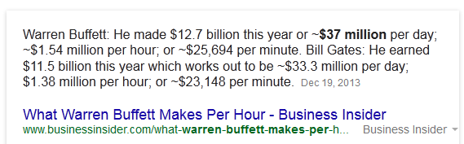
So the average income for the 6 workers is
(5 x $50,000 + 12,700,000,000)/6 = 2,116,708,333 = 2.1 billion dollars!

Slide 42
15 Poorest Countries in 2010
Rank | Country | GDP per Capita
1 | Congo, Dem. Rep. | 282.34
2 | Zimbabwe | 369.15
3 | Burundi | 451.16
4 | Liberia | 493.4
5 | Somalia | 522.35
6 | Niger | 552.34
7 | Central African Republic | 675.31
8 | Eritrea | 705.6
9 | Malawi | 811.07
10 | Ethiopia | 813.21
11 | Madagascar | 815.7
12 | Mozambique | 862.84
13 | Togo | 867.74
14 | Guinea-Bissau | 905.98
15 | Comoros | 976.93

Slide 43
ACTIVE LEARNING ₁
GDP and its components
In each of the following cases, determine how much
GDP and each of its components is affected (if at all).
  A. Debbie spends $200 to buy her husband dinner
  at the finest restaurant in Boston.
  B. Sarah spends $1800 on a new laptop to use in her publishing business. The laptop was built in China.
  C. Jane spends $1200 on a computer to use in her editing business. She got last year’s model on sale for a great price from a local manufacturer.
  D. General Motors builds $500 million worth of cars,
  but consumers only buy $470 million worth of them.
© 2012 Cengage Learning. All Rights Reserved. May not be copied, scanned, or duplicated, in whole or in part, except for use as permitted in a license distributed with a certain product or service or otherwise on a password-protected website for classroom use.
Notes:
Suggestion: Show these questions, and give your students 1–3 minutes to formulate their answers. When you are ready to discuss the answers, go to the next slide…

Slide 44
ACTIVE LEARNING ₁
Answers
A. Debbie spends $200 to buy her husband dinner
at the finest restaurant in Boston.
Consumption and GDP rise by $200.
B. Sarah spends $1800 on a new laptop to use in her publishing business. The laptop was built in China.
Investment rises by $1800, net exports fall
by $1800, GDP is unchanged.
© 2012 Cengage Learning. All Rights Reserved. May not be copied, scanned, or duplicated, in whole or in part, except for use as permitted in a license distributed with a certain product or service or otherwise on a password-protected website for classroom use.
Notes:
Suggestion (continued from previous slide): Show part A (but not the answer) and ask for someone to volunteer his or her response. Then show the answer to part A. Repeat for parts B, C, and D. (The answers to parts C and D appear on the following slide.)
After showing the answer to part A, ask your students whether the answer would be different if Debbie were a government employee. The correct answer is NO. Government employees engage in consumption, just like everyone else.

Slide 45
ACTIVE LEARNING ₁
Answers
C. Jane spends $1200 on a computer to use in her editing business. She got last year’s model on sale for a great price from a local manufacturer.
Current GDP and investment do not change, because the computer was built last year.
D. General Motors builds $500 million worth of cars, but consumers only buy $470 million of them.
Consumption rises by $470 million,
inventory investment rises by $30 million,
and GDP rises by $500 million.
© 2012 Cengage Learning. All Rights Reserved. May not be copied, scanned, or duplicated, in whole or in part, except for use as permitted in a license distributed with a certain product or service or otherwise on a password-protected website for classroom use.
Notes:
Regarding part C:
Jane’s purchase causes investment (for her own business) to increase by $1200. However, the computer is sold out of inventory, so inventory investment falls by $1200. The two transactions cancel each other, leaving aggregate investment and GDP unchanged.
Regarding part D:
This problem illustrates why expenditure always equals output, even when firms don’t sell everything they produce due to lackluster demand. The point here is that unsold output is counted in inventory investment, even when that “investment” was unintentional.

Slide 46
Real versus Nominal GDP
Inflation can distort economic variables like GDP, so we have two versions of GDP:
Nominal GDP
  values output using current prices
  not corrected for inflation
Real GDP
  values output using the prices of a base year
  is corrected for inflation
Notes:
45

Slide 47
EXAMPLE:
 | Pizza |  | Latte
year | P | Q | P | Q
2011 | $10 | 400 | $2.00 | 1000
2012 | $11 | 500 | $2.50 | 1100
2013 | $12 | 600 | $3.00 | 1200
Compute nominal GDP in each year:
2011: $10 x 400 + $2 x 1000 = $6,000
2012: $11 x 500 + $2.50 x 1100 = $8,250
2013: $12 x 600 + $3 x 1200 = $10,800
Increase:
37.5%
30.9%
Notes:
46
This example is similar to that in the text, but using different goods and different numerical values.
Suggestion: Ask your students to compute nominal GDP in each year before revealing the answers. Ask them to compute the rate of increase before revealing the answers.
In this example, nominal GDP grows for two reasons: prices are rising, and the economy is producing a larger quantity of goods.
Thinking of nominal GDP as total income, the increases in income will overstate the increases in society’s well-being because part of these increases are due to inflation.
We need a way to take out the effects of inflation, to see how much people’s incomes are growing in purchasing power terms. That is the job of real GDP.

Slide 48
EXAMPLE:
 | Pizza |  | Latte
year | P | Q | P | Q
2011 | $10 | 400 | $2.00 | 1000
2012 | $11 | 500 | $2.50 | 1100
2013 | $12 | 600 | $3.00 | 1200
$10
$2.00
Compute real GDP in each year,
using 2011 as the base year:
Increase:
2011: $10 x 400 + $2 x 1000 = $6,000
2012: $10 x 500 + $2 x 1100 = $7,200
2013: $10 x 600 + $2 x 1200 = $8,400
20.0%
16.7%
Notes:
47
This example shows that real GDP in every year is constructed using the prices of the base year and that the base year doesn’t change.
The growth rate of real GDP from one year to the next is the answer to this question:
“How much would GDP (and hence everyone’s income) have grown if there had been zero inflation?”
Thus, real GDP is corrected for inflation.

Slide 49
EXAMPLE:
year | Nominal GDP |  | Real GDP
2011 | $6000 |  | $6000
2012 | $8250 |  | $7200
2013 | $10,800 |  | $8400
In each year,
nominal GDP is measured using the (then) current prices.
real GDP is measured using constant prices from the base year (2011 in this example).
Notes:
48
The table in the top half of this slide merely summarizes the answers from the previous two slides. This table will be used shortly to compute the growth rates in nominal and real GDP and to compute the GDP deflator and inflation rates.

Slide 50
EXAMPLE:
year | Nominal GDP |  | Real GDP
2011 | $6000 |  | $6000
2012 | $8250 |  | $7200
2013 | $10,800 |  | $8400
37.5%
20.0%
30.9%
16.7%
The change in nominal GDP reflects both prices and quantities.
The change in real GDP is the amount that
GDP would change if prices were constant
(i.e., if zero inflation).
Hence, real GDP is corrected for inflation.
Notes:
49
Again, the growth rate of real GDP from one year to the next is the answer to this question:
“How much would GDP (and hence everyone’s income) have grown if there had been zero inflation?”
This is why real GDP is corrected for inflation.

Slide 51
Nominal and Real GDP in the U.S.,
1965–2010
Real GDP (base year 2005)
billions
Nominal GDP
Notes:
50
The source I used: http://research.stlouisfed.org/fred2/
The original source: U.S. Department of Commerce: Bureau of Economic Analysis
Since you have just finished covering real vs. nominal GDP, it might be worthwhile pointing out the following to your students:
The graph shows that nominal GDP rises faster than real GDP. This should make sense, because growth in nominal GDP is driven by growth in output AND by inflation. Growth in real GDP is driven only by growth in output.
The two lines cross in the year 2005 (the base year for the real GDP data in this graph). This should make sense because real GDP equals nominal GDP in the base year. (Better yet, ask your students whether there’s anything significant about the point where the two lines cross.)
Before the base year, real GDP > nominal GDP. For example, in 1981, nominal GDP is about $3 trillion, while real GDP is about $6 trillion (in 2005 dollars). This should make sense because prices were so much higher in 2005 than in 1981, so using those high 2005 prices to value 1981 output would lead to a bigger result than valuing 1981 output using 1981 prices.
Similarly, after 2005, nominal GDP is higher than real GDP because prices are higher in later years than they were in 2005.

Slide 52
The GDP Deflator
The GDP deflator is a measure of the overall level of prices.
Definition:
GDP deflator = 100 x
nominal GDP
real GDP
One way to measure the economy’s inflation rate is to compute the percentage increase in the GDP deflator from one year to the next.
Notes:
51
The GDP Deflator gets its name because it is used to “deflate” (i.e., take the inflation out of) nominal GDP to get real GDP.

Slide 53
EXAMPLE:
year | Nominal GDP | Real GDP | GDP Deflator
2011 | $6000 | $6000
2012 | $8250 | $7200
2013 | $10,800 | $8400
100.0
14.6%
114.6
12.2%
128.6
Compute the GDP deflator in each year:
2011: 100 x (6000/6000) = 100.0
2012: 100 x (8250/7200) = 114.6
2013: 100 x (10,800/8400) = 128.6
Notes:
52

Slide 54
ACTIVE LEARNING ₂
Computing GDP
 | 2011 (base yr) |  | 2012 |  | 2013
 | P | Q | P | Q | P | Q
Good A | $30 | 900 | $31 | 1000 | $36 | 1050
Good B | $100 | 192 | $102 | 200 | $100 | 205
Use the above data to solve these problems:
  A. Compute nominal GDP in 2011.
  B. Compute real GDP in 2012.
  C. Compute the GDP deflator in 2013.
© 2012 Cengage Learning. All Rights Reserved. May not be copied, scanned, or duplicated, in whole or in part, except for use as permitted in a license distributed with a certain product or service or otherwise on a password-protected website for classroom use.
Notes:
The data in the table are for a hypothetical economy that produces two final goods, A and B. For all parts of this problem, use 2011 as the base year.
If you’re running short on time, you can skip part A—it’s the least challenging. If you only have time for one of the three, you might skip A and B, as C by itself covers all of the material: it requires students to compute nominal and real GDP before they can compute the GDP deflator.

Slide 55
ACTIVE LEARNING ₂
Answers
 | 2011 (base yr) |  | 2012 |  | 2013
 | P | Q | P | Q | P | Q
Good A | $30 | 900 | $31 | 1,000 | $36 | 1050
Good B | $100 | 192 | $102 | 200 | $100 | 205
A. Compute nominal GDP in 2011.
$30 x 900 + $100 x 192 = $46,200
B. Compute real GDP in 2012.
$30 x 1000 + $100 x 200 = $50,000
© 2012 Cengage Learning. All Rights Reserved. May not be copied, scanned, or duplicated, in whole or in part, except for use as permitted in a license distributed with a certain product or service or otherwise on a password-protected website for classroom use.

Slide 56
ACTIVE LEARNING ₂
Answers
 | 2011 (base yr) |  | 2012 |  | 2013
 | P | Q | P | Q | P | Q
Good A | $30 | 900 | $31 | 1,000 | $36 | 1050
Good B | $100 | 192 | $102 | 200 | $100 | 205
C. Compute the GDP deflator in 2013.
Nom GDP = $36 x 1050 + $100 x 205 = $58,300
Real GDP = $30 x 1050 + $100 x 205 = $52,000
GDP deflator = 100 x (Nom GDP)/(Real GDP)
= 100 x ($58,300)/($52,000) = 112.1
© 2012 Cengage Learning. All Rights Reserved. May not be copied, scanned, or duplicated, in whole or in part, except for use as permitted in a license distributed with a certain product or service or otherwise on a password-protected website for classroom use.

Slide 57
GDP and Economic Well-Being
Real GDP per capita is the main indicator of the average person’s standard of living.
But GDP is not a perfect measure of
well-being.
Robert Kennedy issued a very eloquent
yet harsh criticism of GDP:
Notes:
56
Most economists, policymakers, social scientists, and businesspersons use a country’s real GDP per capita as the main indicator of the average person’s standard of living in that country.

Slide 58

Gross Domestic Product…
“… does not allow for the health of our
children, the quality of their education,
or the joy of their play.
It does not
include the beauty of our poetry or
the strength of our marriages, the
intelligence of our public debate or
the integrity of our public officials.
It measures neither our courage, nor our wisdom,
nor our devotion to our country.
It measures everything, in short, except that which makes life worthwhile, and it can tell us everything about America except why we are proud that we are Americans.”
- Senator Robert Kennedy, 1968
Notes:
57
Very scathing words, indeed!

Slide 59
GDP Does Not Value:
the quality of the environment
leisure time
non-market activity, such as the child care
a parent provides his or her child at home
an equitable distribution of income
Notes:
58
Much of what Robert Kennedy said about GDP is correct.

Slide 60
Then Why Do We Care About GDP?
Having a large GDP enables a country to afford better schools, a cleaner environment,
health care, etc.
Many indicators of the quality of life are positively correlated with GDP. For example…
Notes:
59
Then why do we care about GDP?
Because a large GDP does in fact help us to lead a good life. GDP does not measure the health of our children, but nations with larger GDP can afford better health care for their children. GDP does not measure the beauty of our poetry, but nations with larger GDP can afford to teach more of their citizens to read and enjoy poetry. GDP does not take account of our intelligence, integrity, courage, wisdom, or devotion to country, but all of these laudable attributes are easier to foster when people are less concerned about being able to afford the material necessities of life.
In short, GDP does not directly measure those things that make life worthwhile, but it does measure our ability to obtain the inputs into a worthwhile life.

Slide 61
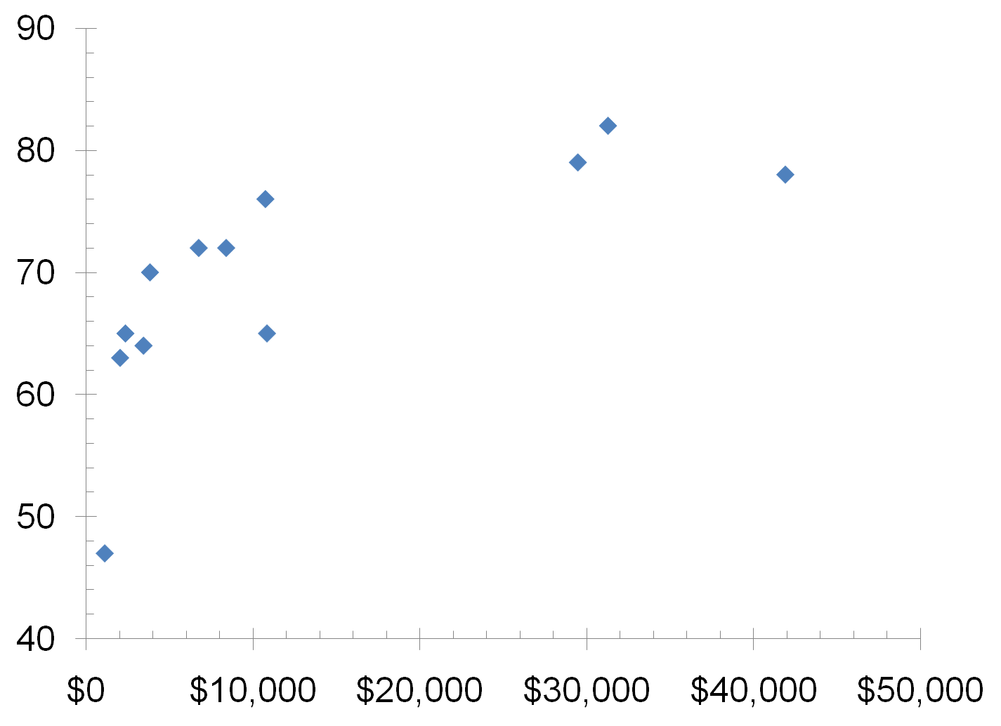
GDP and Life Expectancy in 12 countries
Indonesia
Japan
China
U.S.
Mexico
Germany
Brazil
Pakistan
Life expectancy (years)
Russia
India
Bangladesh
Nigeria
Real GDP per capita
60
Notes:
This figure and the two that follow are from the data in Table 3 of the textbook.
Real GDP per capita figures are expressed in U.S. dollars.
Source: Human Development Report 2007/2008, United Nations.

Slide 62
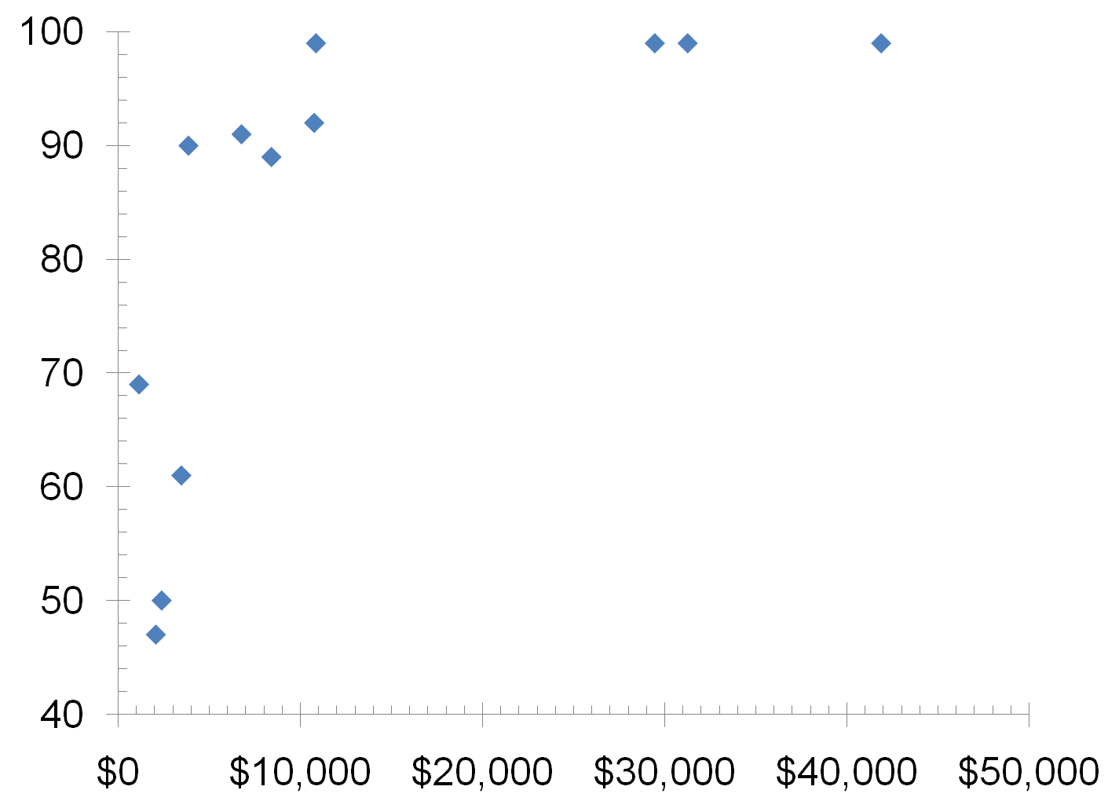
GDP and Literacy in 12 countries
China
Russia
U.S.
Germany
Japan
Mexico
Brazil
Indonesia
Adult Literacy
(% of population)
Nigeria
India
Pakistan
Bangladesh
Real GDP per capita
61
Notes:
Source: Human Development Report 2007/2008, United Nations.

Slide 63
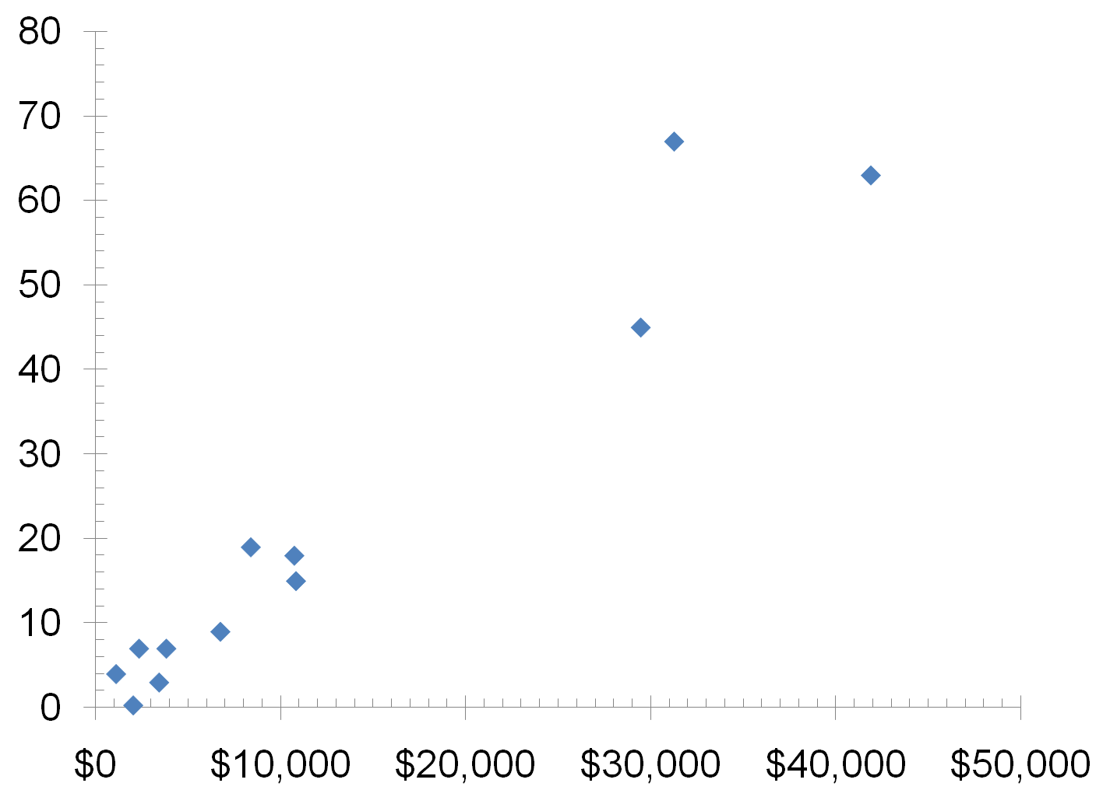
GDP and Internet Usage in 12 countries
Japan
U.S.
Germany
Internet Usage
(% of population)
Brazil
Indonesia
Mexico
Pakistan
Russia
China
Nigeria
India
Real GDP per capita
Bangladesh
62
Notes:
Source: Human Development Report 2007/2008, United Nations.

Slide 64
SUMMARY
Gross Domestic Product (GDP) measures a country’s total income and expenditure.
The four spending components of GDP include: Consumption, Investment, Government Purchases, and Net Exports.
Nominal GDP is measured using current prices. Real GDP is measured using the prices of a constant base year and is corrected for inflation.
GDP is the main indicator of a country’s economic well-being, even though it is not perfect.
© 2012 Cengage Learning. All Rights Reserved. May not be copied, scanned, or duplicated, in whole or in part, except for use as permitted in a license distributed with a certain product or service or otherwise on a password-protected website for classroom use.

